Slide 1
Project Title: Direct charge from Otumara for spare transmitter order
Business Case/objectives:
Following the loading of IMOR spares into HDMMS, spares requested from the location by other assets are banked as cash generation and as FCF to the business
Objective:
Revenue generation and cost avoidance to the business in utilizing available spares in own storage locations
Potential Benefits & Measurement:
circa $ 865.91 includes shipping cost
Project Scope/Actions :
Received order request from Otumara
Oobtain asset approval
Liaise with hot desk for direct charge transfer
Send spare material pressure transmitter -HART) to Otumara
Critical Success Factors:
Engagement with Otumara leadership
Help desk support
Logistics request
Okoloma/IMOR PU leadership support
High-level Timeline:
L0-L1: September2018
L2: September2018
L3: September2018
L4: September2018
L5: September2018
Initiative End
Project Sponsor: Onyeka Ikechukwu /Bashorun Oladimeji Implementation Lead: Musa Mohammed A.
Project Team:
Musa Mohammed A
Braide Matilda

Slide 2
Project Title: Resolve Fire water Allen Bradley PLC Communication fault
Business Case/objectives:
The fire water control system (Allen Bradley PLC) has had a long standing fault, hindering remote indication to the DCS and fire water ring main pressure stabilization. The PLC also has a Local display panel (HMI) that displays functional alarms and control system operation status.
Objective:
Restore control room operator remote visual of fire water ring main process automation and functionality
Potential Benefits & Measurement:
circa $ 8000 in FSR fees
Project Scope/Actions :
Conducted DIY based troubleshooting and fault finding
Secured/obtained PLC program from project team
Procured identified defective parts and software
Self taught on the use RS Logix software for troubleshooting and connection to PLC
Replaced defective parts and restored full functionality of the PLC
Critical Success Factors:
Leadership support
C & P for material order
Collaboration within the team
Problem solving skills
High-level Timeline:
L0-L1: September2018
L2: September2018
L3: September2018
L4: September2018
L5: September2018
Initiative End
Project Sponsor: Onyeka Ikechukwu /Bashorun Oladimeji Implementation Lead: Ogbodu Oghenerume
Project Team:
Musa Mohammed A
Obinna Amaizu

Slide 3
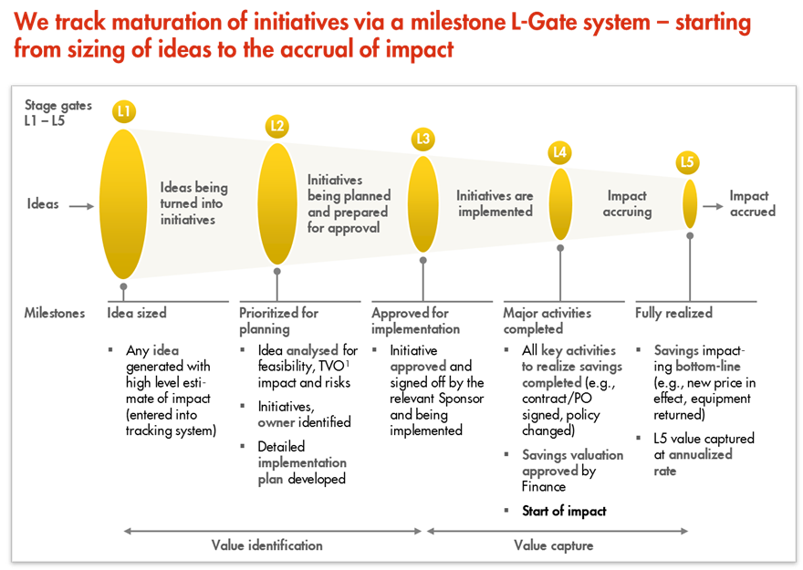
L1 – L5 Gates

